Slide 1

International Task Force on Teachers for Education 2030
Using enhanced data to improve teacher management
Martin Gustafsson
Department of Basic Education/Stellenbosch University
South Africa
February 2024

Slide 2
My focus specific focus will be on generating projections of teacher numbers and their unit costs in the coming years.
I’ll draw from work done since 2022 by the South African Department of Basic Education with partners, including RESEP at Stellenbosch University.
tdd.sun.ac.za

Slide 3
So much of what can be done is determined by the available data describing the baseline and recent trends.
Enrolment, by specialisation and language of instruction
Official demographic statistics
[Trends perhaps okay, less so levels – use EMIS data to verify]
Population trends by region
Population projections, UN and perhaps local
Teachers by age and…
…by salary level and rank
…by first/last appearance year
…outside teacher employment
…by level/subject qualification
…by language
Payroll data
[Probably not the ideal source of all teacher data]
Household data
Other individual teacher data (EMIS?)
ATTRITION RATES BY AGE!
Newly graduated teachers
…by level/subject qualification
…by language fluency
Data on graduates from training institutions
[Data privacy questions and data linking]

Slide 4
And skills?
General data management skills – remember datasets can be large
Teams of both data and policy specialists who can make sense of recent trends
Some programming skills, e.g. VBA in Excel often relatively accessible

Slide 5
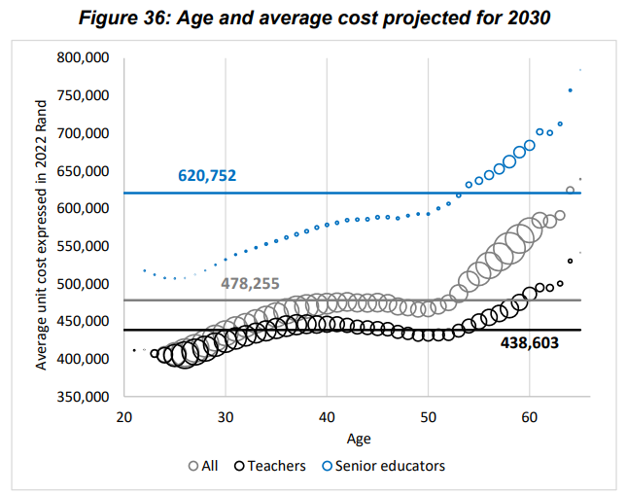
An example from one of our reports
Width of bubbles reflect people.
Clearly, changing age distributions influence average unit cost.

Slide 6


